Slide 1
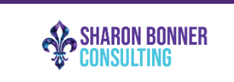
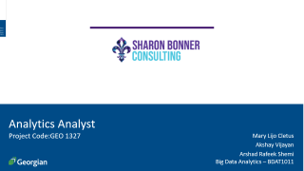
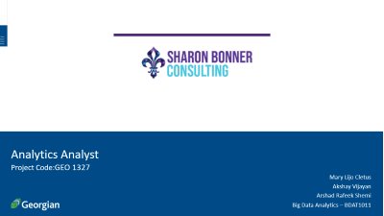
Analytics Analyst
Project Code:GEO 1327
Mary Lijo Cletus
Akshay Vijayan
Arshad Rafeek Shemi
Big Data Analytics – BDAT1011

Slide 2
Project Summary
The project will be focused on Digital Marketing Analysts and will be responsible for analyzing data from insights and reports from Sharon Bonner Consulting social media platforms. We will review and analyze the current and projected marketing initiatives and provide suggestions. Analyze keywords to determine relevant search terms to the organization and ensure the Search Engine Optimization. And finally, to analyze the overall business and provide recommendations on the current strategies. The project objectives are:
1. Conduct analysis that results in actionable insights and data-driven recommendations.
2. Identify, communicate, and act on opportunities and risks proactively.
3. Report and present performance and recommendations.

Slide 3
Team Profile
Akshay Vijayan
Arshad Rafeek Shemi
Mary Lijo Cletus
Developer
Business Analyst
Data Analyst
Data analysis and data visualization
Managing proper communication between client and the team,
Data analysis
Managing cleaning and developing solutions from data
Development and testing

Slide 4
Project Objectives
• Conduct analysis that results in actionable insights and data-driven recommendations.
• Identify, communicate, and act on opportunities and risks proactively.
• Report and present performance and recommendations.
Project Requirements
• A strategy to make everyone understand the different between event consulting and event producing.
• A strategy to get clients for Sharon Bonner Consulting from the historical data of Bright Ideas event agency.
• Immediate actionable insights that can be implemented for the initial push for the company.
• A 3–5-year analytical strategy for the company to move forward with event consulting.

Slide 5
Scope of Project
1) Analysis of data obtained from client or from other external sources that results in actionable insights and data-driven recommendations.
2) Report and present performance and recommendations.
3) Analytical strategy for 3–5-years prepared for the company to focus on event consulting industry.

Slide 6
Project Outcomes
• Getting proper data driven recommendations in marketing of the company
• Getting to know about new opportunities and risks of event consulting industry
• Get a detailed analysis report of previous clients and data
• Get project deliverables which can be used for future research purposes.
Project Deliverables
1. A final report with data-driven suggestions and reflections on how to improve our business
2. A 3–5-year future analytical plan
3. Immediate actionable insights that we can implement

Slide 7
Communication Plan
Name | Role | Send/Receive Email | Weekly Meetings | Decisions | Documentation
Sharon Bonner | Stakeholder | Yes | Attend | Project Scope | Project documentation
Thecla Oreme | Instructor | Yes | Optional Attendee | Progression of Project | Grading
Thecla Oreme | Project Manager | Yes | Suggested Attendee | Project and Task Management related items | Project Management Presentation components
Akshay Vijayan | Team Lead | Yes | Attend, Book | Team, Project and Own Tasks | Communication
Arshad Rafeek Shemi | Team Member | Yes | Attend, Agenda | Own Tasks | Documentation of different project phase
Mary Lijo Cletus | Team Member | Yes | Attend, Minutes | Own Tasks | Documentation of different project phase

Slide 8
High-Level Timeline Chart (GANTT)

Slide 9
Budget
Current Cost of Project
Task | Hours | Rate | Total
Akshay Vijayan | 8 | $ 50.00 | $ 400.00
Arshad Rafeek Shemi | 8 | $ 50.00 | $ 400.00
Mary Lijo Cletus | 8 | $ 50.00 | $ 400.00
Total |  |  | $ 1200.00
A total budget off $4800 per person ($400 x 12 weeks)

Slide 10
Project Progress Update
Analysis of Client Website
Analyzed the client website ie the Sharon Bonner Consultancy Website
Provided suggestions to the clients based on the analysis for their recent website modification. Suggestions and analysis results were shared to client by a power point presentation during the client meeting
We used Gtmatrix for the analysis as our tool

Slide 11
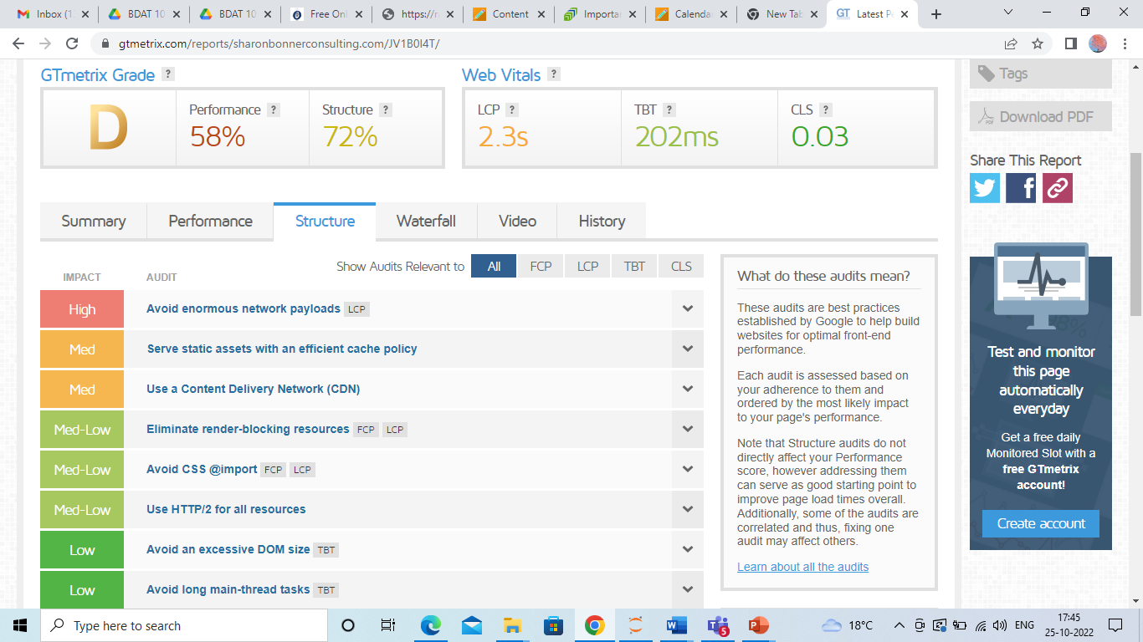
Screenshots of the visualizations that we have created for website Analysis

Slide 12
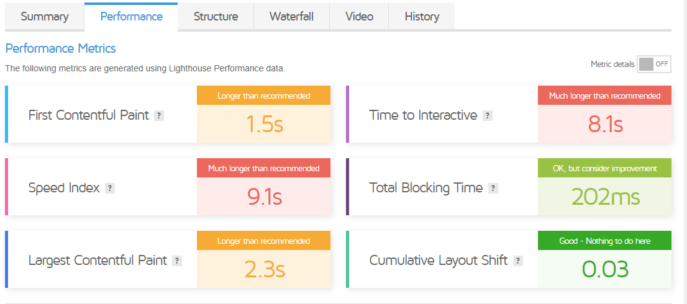

Slide 13
Major Observations
Great Website Content
Vlogs in the website is also meaningful and good
Portfolio Section in the website is also good
Images provided in the website are oversized as a result the clarity of the images are affected
Loading time of the website is more.
The overall view of the website is a combination of blue and lavender same as in the logo which can be made more attractive

Slide 14
If the size of the images are compressed properly and then uploaded into the website, then the image quality will increase at the same time the speed of the website will also improve as it reduces the loading time
Suggestions Given to client

Slide 15
Analysis of Google Analytics Data
The analysis of Sharon Bonner consultancy’s Goggle analytics data is done and assumptions were calculated based on the customer flow and the trend that is observed in the customer flow.
A dashboard was created based on the analysis of the google analytics data.

Slide 16
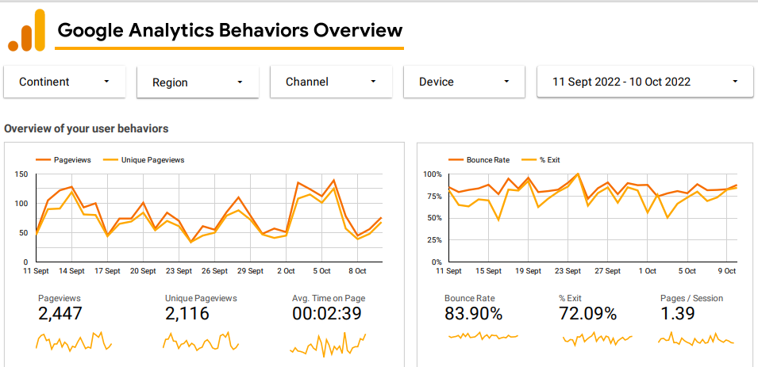

Slide 17
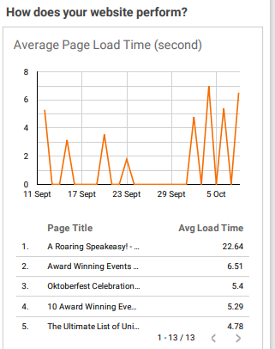
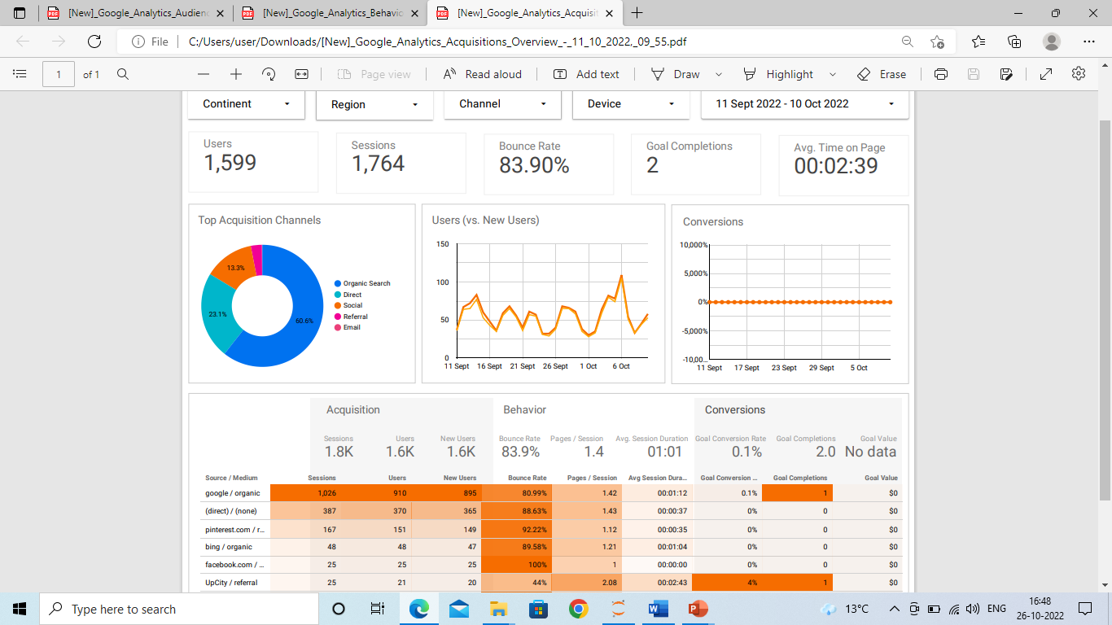

Slide 18
Findings From Google analytics data
Maximum customers are through Google search
Maximum viewed page is About page of the client
There is an improved user count seen in the middle of the month of October
Can concentrate more on social media platforms to increase the clients
Can concentrate more on google paid adds to maintain the high flow of customers through the google search

Slide 19
Social Media Analysis
Social media analysis of our client is done .
Social media accounts like Instagram , Facebook and LinkedIn is analyzed
Found that the social media accounts are well maintained but there is scope
for improvement to attract more users

Slide 20
Activities in Progress
Preparing for the dashboard creation based on the Social Media Analysis done for the client website
Preparing for the Next client meeting

Slide 21
Backlogs and Schedules
No backlogs so far
Next client meeting will be according to the client's availability

Slide 22
Activities and Works so far
First Client meeting was done on 21/09/2022
Second Client meeting was done on 29/09/2022
Third Client meeting was done on 13/10/2022
Immediate recommendations on website provided for the client's website updation
Detailed analysis of the client social media
Analysis of google analytics of client website

Slide 23
Plan for Next week
Dashboard presentation based on the analysis on social media Analysis
Preparation for next client meeting
Data Collection for making 3-to-5-year plan

Slide 24
Individual Status Report – Akshay Vijayan
Research on Data Scrapping for the 3-to-5-year analysis

Slide 25
Individual Status Report – Mary Lijo Cletus
Dashboard creation for social media analysis

Slide 26
Individual Status Report – Arshad Rafeek Shemi
Maintaining proper communication between client and team
Research on Data collection for 5 year plan

Slide 27
Questions and Answers
What in case client don’t have adequate data to provide the team?

Slide 28
Conclusion
In this project we conduct analysis that results in actionable insights and data-driven recommendations. This is a great project for us to prove our analyzing expertise for future employers, as the impact of our work on this project can be easily measured and communicated. We here by thank the entire Georgian College faculty from Big Data Analytics program.

